Slide 1
Threats and Attacks
Notes:
THREATS TO INFORMATION SECURITY
To make sound decisions about information security, create policies, and enforce them, management must be informed of the various kinds of threats facing the organization, its applications, data and information systems.
A threat is an object, person, or other entity that represents a constant danger to an asset.
To better understand the numerous threats facing the organization, a categorization scheme has been developed allowing us to group threats by their respective activities.
By examining each threat category in turn, management can most effectively protect its information through policy, education and training, and technology controls.

Slide 2
Learning Objectives Upon completion of this material, you should be able to:
Identify and understand the threats posed to information security
Identify and understand the more common attacks associated with those threats
Notes:
Learning Objectives:
Upon completion of this chapter, you should be able to:
Understand the business need for information security.
Understand a successful information security program is the responsibility of an organization’s general management and IT management.
Understand the threats posed to information security and the more common attacks associated with those threats.
Differentiate threats to information systems from attacks against information systems.

Slide 3
Threats
Threat: an object, person, or other entity that represents a constant danger to an asset
Management must be informed of the different threats facing the organization
By examining each threat category, management effectively protects information through policy, education, training, and technology controls
Notes:
THREATS TO INFORMATION SECURITY
To make sound decisions about information security, create policies, and enforce them, management must be informed of the various kinds of threats facing the organization, its applications, data and information systems.
A threat is an object, person, or other entity that represents a constant danger to an asset.
To better understand the numerous threats facing the organization, a categorization scheme has been developed allowing us to group threats by their respective activities.
By examining each threat category in turn, management can most effectively protect its information through policy, education and training, and technology controls.

Slide 4
Threats (continued)
The 2004 Computer Security Institute (CSI)/Federal Bureau of Investigation (FBI) survey found:
79 percent of organizations reported cyber security breaches within the last 12 months
54 percent of those organizations reported financial losses totaling over $141 million
Notes:
THREATS TO INFORMATION SECURITY
The 2002 Computer Security Institute/Federal Bureau of Investigation (CSI/FBI) survey on Computer Crime and Security Survey found:
90% of organizations responding, primarily large corporations and government agencies, detected computer security breaches within the last year.
80% of these organizations lost money to computer breaches, totaling over $455,848,000 up from $377,828,700 reported in 2001.
The number of attacks that came across the Internet rose from 70% in 2001 to 74% in 2002.
Only 34% of organizations reported their attacks to law enforcement.

Slide 5
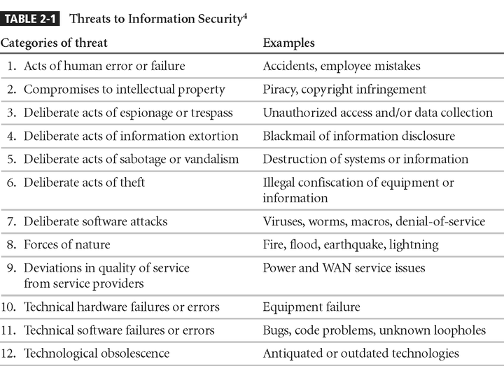
Threats to Information Security
Notes:
1. Potential Acts of Human Error or Failure
2. Compromises to Intellectual Property
3. Deliberate Acts of Espionage or Trespass
4. Deliberate Acts of Information Extortion
5. Deliberate Acts of Sabotage or Vandalism
6. Deliberate Acts of Theft
7. Deliberate Software Attacks
8. Forces of Nature
9. Potential Deviations in Quality of Service from Service Providers
10. Technical Hardware Failures or Errors
11. Technical Software Failures or Errors
12. Technological Obsolescence

Slide 6
Acts of Human Error or Failure
Includes acts performed without malicious intent
Causes include:
Inexperience
Improper training
Incorrect assumptions
Employees are among the greatest threats to an organization’s data
Notes:
Potential Acts of Human Error or Failure
This category includes the possibility of acts performed without intent or malicious purpose by an individual who is an employee of an organization.
Inexperience, improper training, the making of incorrect assumptions, and other circumstances can cause problems.
Employees constitute one of the greatest threats to information security, as the individuals closest to the organizational data.
Employee mistakes can easily lead to the following: revelation of classified data, entry of erroneous data, accidental deletion or modification of data, storage of data in unprotected areas, and failure to protect information.
Many threats can be prevented with controls, ranging from simple procedures, such as requiring the user to type a critical command twice, to more complex procedures, such as the verification of commands by a second party.

Slide 7
Acts of Human Error or Failure (continued)
Employee mistakes can easily lead to:
Revelation of classified data
Entry of erroneous data
Accidental data deletion or modification
Data storage in unprotected areas
Failure to protect information
Many of these threats can be prevented with controls
Notes:
Potential Acts of Human Error or Failure
This category includes the possibility of acts performed without intent or malicious purpose by an individual who is an employee of an organization.
Inexperience, improper training, the making of incorrect assumptions, and other circumstances can cause problems.
Employees constitute one of the greatest threats to information security, as the individuals closest to the organizational data.
Employee mistakes can easily lead to the following: revelation of classified data, entry of erroneous data, accidental deletion or modification of data, storage of data in unprotected areas, and failure to protect information.
Many threats can be prevented with controls, ranging from simple procedures, such as requiring the user to type a critical command twice, to more complex procedures, such as the verification of commands by a second party.

Slide 8
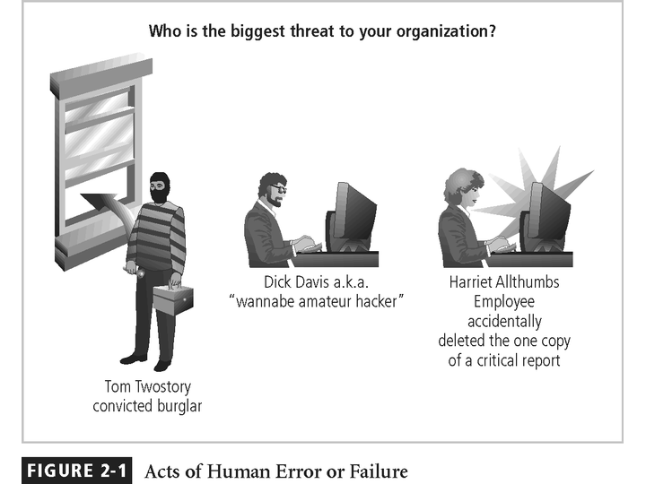
Figure 2-1 – Acts of Human Error or Failure

Slide 9
Deliberate Acts of Espionage or Trespass
Access of protected information by unauthorized individuals
Competitive intelligence (legal) vs. industrial espionage (illegal)
Shoulder surfing occurs anywhere a person accesses confidential information
Controls let trespassers know they are encroaching on organization’s cyberspace
Hackers uses skill, guile, or fraud to bypass controls protecting others’ information
Notes:
Deliberate Acts of Espionage or Trespass
This threat represents a well-known and broad category of electronic and human activities that breach the confidentiality of information.
When an unauthorized individual gains access to the information an organization is trying to protect, that act is categorized as a deliberate act of espionage or trespass.
When information gatherers employ techniques that cross the threshold of what is legal and/or ethical, they enter the world of industrial espionage.
Instances of shoulder surfing occur at computer terminals, desks, ATM machines, public phones, or other places where a person is accessing confidential information.
Deliberate Acts of Espionage or Trespass
The threat of Trespass can lead to unauthorized, real or virtual actions that enable information gatherers to enter premises or systems they have not been authorized to enter.
Controls are sometimes implemented to mark the boundaries of an organization’s virtual territory.
These boundaries give notice to trespassers that they are encroaching on the organization’s cyberspace.
The classic perpetrator of deliberate acts of espionage or trespass is the hacker.
In the gritty world of reality, a hacker uses skill, guile, or fraud to attempt to bypass the controls placed around information that is the property of someone else. The hacker frequently spends long hours examining the types and structures of the targeted systems.

Slide 10
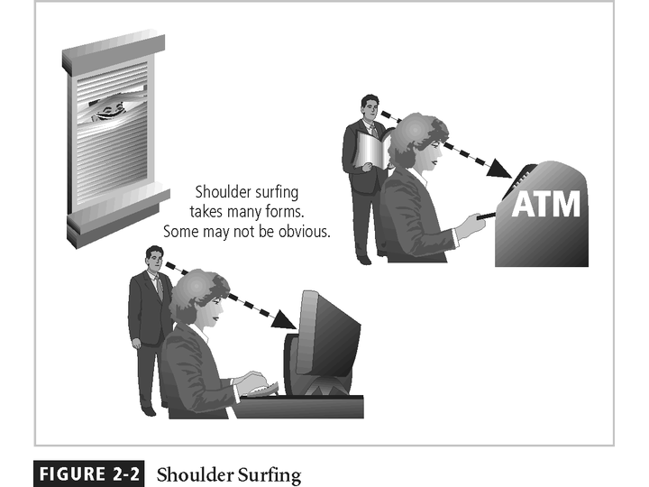

Slide 11
Deliberate Acts of Theft
Illegal taking of another’s physical, electronic, or intellectual property
Physical theft is controlled relatively easily
Electronic theft is more complex problem; evidence of crime not readily apparent
Notes:
Deliberate Acts of Theft
Theft is the illegal taking of another’s property. Within an organization, that property can be physical, electronic, or intellectual.
The value of information suffers when it is copied and taken away without the owner’s knowledge.
Physical theft can be controlled quite easily. A wide variety of measures can be used from simple locked doors, to trained security personnel, and the installation of alarm systems.
Electronic theft, however, is a more complex problem to manage and control. Organizations may not even know it has occurred.

Slide 12
Deliberate Software Attacks
Malicious software (malware) designed to damage, destroy, or deny service to target systems
Includes viruses, worms, Trojan horses, logic bombs, back doors, and denial-of-services attacks
Notes:
Deliberate Software Attacks
See separate presentation BSC4_NS_MALEWARE

Slide 13
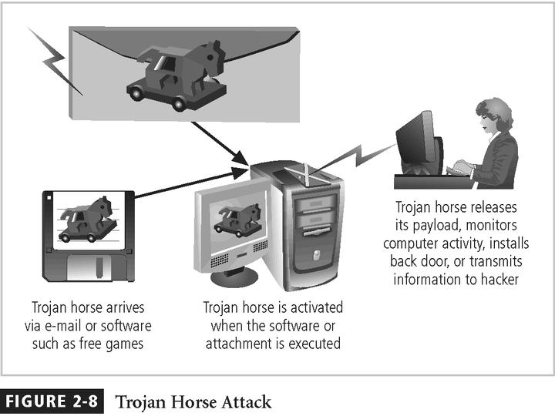

Slide 14
Forces of Nature
Forces of nature are among the most dangerous threats
Disrupt not only individual lives, but also storage, transmission, and use of information
Organizations must implement controls to limit damage and prepare contingency plans for continued operations
Notes:
Forces of Nature
Forces of nature, force majeure, or acts of God pose the most dangerous threats, because they are unexpected and can occur with very little warning.
These threats can disrupt not only the lives of individuals, but also the storage, transmission, and use of information.
These include fire, flood, earthquake, and lightning as well as volcanic eruption and insect infestation.
Since it is not possible to avoid many of these threats, management must implement controls to limit damage and also prepare contingency plans for continued operations.

Slide 15
Deviations in Quality of Service
Includes situations where products or services not delivered as expected
Information system depends on many interdependent support systems
Internet service, communications, and power irregularities dramatically affect availability of information and systems
Notes:
Potential Deviations in Quality of Service by Service Providers
This category represents situations in which a product or services are not delivered to the organization as expected.
The organization’s information system depends on the successful operation of many inter-dependent support systems including, power grids, telecom networks, parts suppliers, service vendors, and even the janitorial staff and garbage haulers.
Internet service, communications, and power irregularities are three sets of service issues that dramatically affect the availability of information and systems.

Slide 16
Internet Service Issues
Internet service provider (ISP) failures can considerably undermine availability of information
Outsourced Web hosting provider assumes responsibility for all Internet services as well as hardware and Web site operating system software
Notes:
Internet Service Issues
For organizations that rely heavily on the Internet and the Web to support continued operations, the threat of the potential loss of Internet service can lead to considerable loss in the availability of information.
Many organizations have sales staff and telecommuters working at remote locations.
When an organization places its web servers in the care of a Web Hosting provider, that outsourcer assumes responsibility for all Internet Services as well as for the hardware and operating system software used to operate the web site.

Slide 17
Attacks
Act or action that exploits vulnerability (i.e., an identified weakness) in controlled system
Accomplished by threat agent which damages or steals organization’s information
Notes:
ATTACKS
An attack is the deliberate act that exploits vulnerability.
It is accomplished by a threat-agent to damage or steal an organization’s information or physical asset.
An exploit is a technique to compromise a system. Vulnerability is an identified weakness of a controlled system whose controls are not present or are no longer effective. An attack is then the use of an exploit to achieve the compromise of a controlled system.

Slide 18
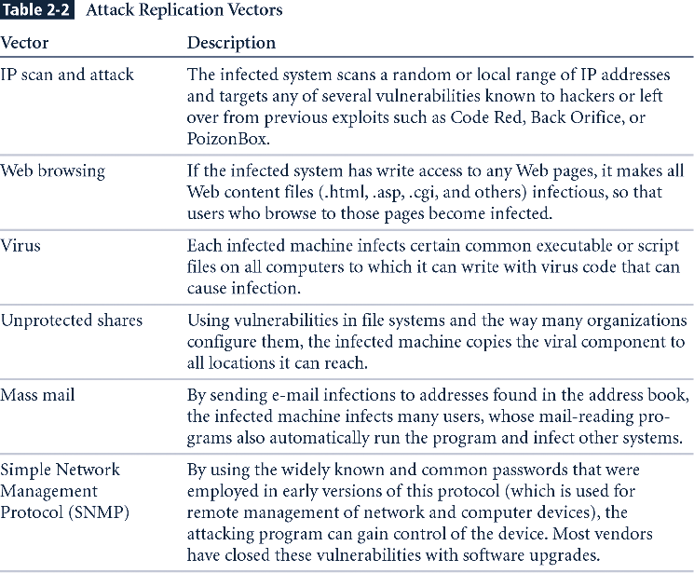
Table 2-2 - Attack Replication Vectors
New Table

Slide 19
Code Red
Code Red was a computer worm observed on the Internet on July 13, 2001. It attacked computers running Microsoft's web server.
The Code Red worm was first discovered and researched by eEye Digital Security employees Marc Maiffret and Ryan Permeh. They named it "Code Red" because Code Red Mountain Dew was what they were drinking at the time.
Although the worm had been released on July 13, the largest group of infected computers was seen on July 19, 2001. On this day, the number of infected hosts reached 359,000

Slide 20
Back Orifice (often shortened to BO) is a controversial computer program designed for remote system administration. It enables a user to control a computer running the Microsoft Windows operating system from a remote location. The name is a word play on Microsoft BackOffice Serversoftware.
Back Orifice was designed with a client–server architecture. A small and unobtrusive server program is installed on one machine, which is remotely manipulated by a client program with a graphical user interface on another computer system. The two components communicate with one another using the TCP and/or UDP network protocols. The program debuted at DEF CON 6 on August 1, 1998. For those and other reasons, the antivirus industry immediately categorized the tool as malware and appended Back Orifice to their quarantine lists

Slide 21
Attacks (continued)
Malicious code: includes execution of viruses, worms, Trojan horses, and active Web scripts with intent to destroy or steal information
Back door: gaining access to system or network using known or previously unknown/newly discovered access mechanism
Notes:
Malicious Code
This kind of attack includes the execution of viruses, worms, Trojan horses, and active web scripts with the intent to destroy or steal information.
The state of the art in attacking systems in 2002 is the multi-vector worm.
These attack programs use up to six known attack vectors to exploit a variety of vulnerabilities in commonly found information system devices.

Slide 22
Attacks (continued)
Password crack: attempting to reverse calculate a password
Brute force: trying every possible combination of options of a password
Dictionary: selects specific accounts to attack and uses commonly used passwords (i.e., the dictionary) to guide guesses
Notes:
Attack Descriptions
Back Doors - Using a known or previously unknown and newly discovered access mechanism, an attacker can gain access to a system or network resource.
Password Crack - Attempting to reverse calculate a password.
Brute Force - The application of computing and network resources to try every possible combination of options of a password.
Dictionary - The dictionary password attack narrows the field by selecting specific accounts to attack and uses a list of commonly used passwords (the dictionary) to guess with.

Slide 23
Attacks (continued)
Denial-of-service (DoS): attacker sends large number of connection or information requests to a target
Target system cannot handle successfully along with other, legitimate service requests
May result in system crash or inability to perform ordinary functions
Distributed denial-of-service (DDoS): coordinated stream of requests is launched against target from many locations simultaneously
Notes:
Attack Descriptions
Denial-of-service (DoS) - the attacker sends a large number of connection or information requests to a target. So many requests are made that the target system cannot handle them successfully along with other, legitimate requests for service. This may result in a system crash, or merely an inability to perform ordinary functions.
Distributed Denial-of-service (DDoS) - an attack in which a coordinated stream of requests is launched against a target from many locations at the same time.

Slide 24
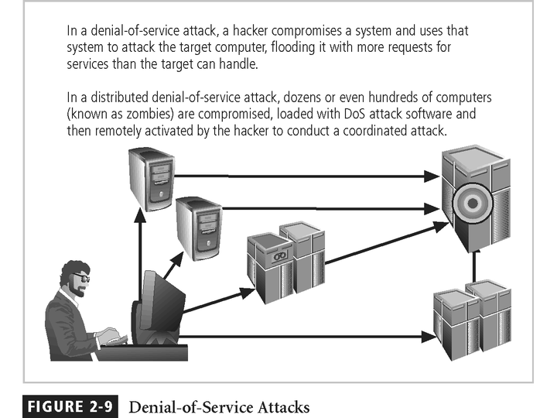
Figure 2-9 - Denial-of-Service Attacks

Slide 25
Attacks (continued)
Spoofing: technique used to gain unauthorized access; intruder assumes a trusted IP address
Man-in-the-middle: attacker monitors network packets, modifies them, and inserts them back into network
Spam: unsolicited commercial e-mail; more a nuisance than an attack, though is emerging as a vector for some attacks
Notes:
Attack Descriptions
Spoofing - a technique used to gain unauthorized access to computers, whereby the intruder sends messages to a computer with an IP address indicating that the message is coming from a trusted host.
Man-in-the-Middle - In the man-in-the-middle or TCP hijacking attack, an attacker sniffs packets from the network, modifies them, and inserts them back into the network.
Spam - unsolicited commercial e-mail. While many consider Spam a nuisance rather than an attack, it is emerging as a vector for some attacks.

Slide 26
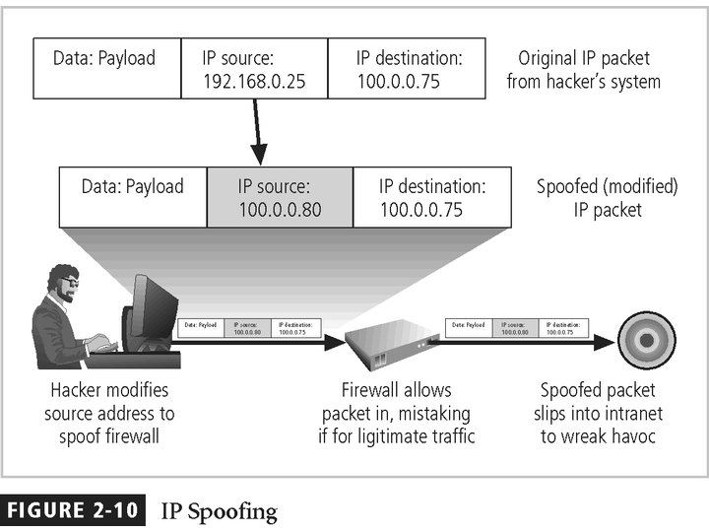

Slide 27
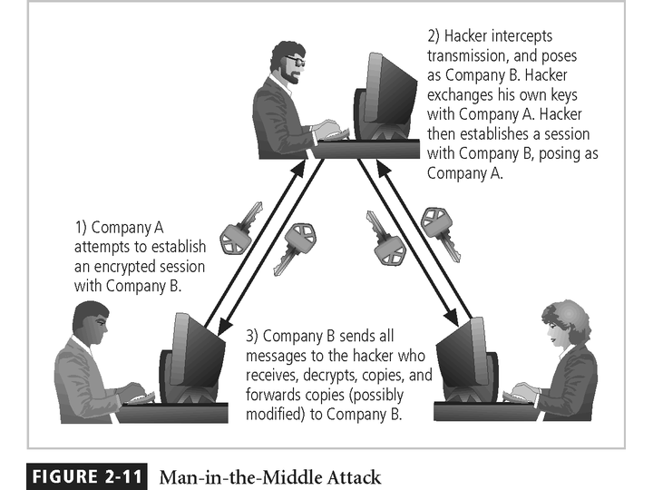
Figure 2-11 - Man-in-the-Middle

Slide 28
Attacks (continued)
Mail bombing: also a DoS; attacker routes large quantities of e-mail to target
Sniffers: program or device that monitors data traveling over network; can be used both for legitimate purposes and for stealing information from a network
Social engineering: using social skills to convince people to reveal access credentials or other valuable information to attacker
Notes:
Attack Descriptions
Mail-bombing - Another form of e-mail attack that is also a DoS, in which an attacker routes large quantities of e-mail to the target.
Sniffers - a program and/or device that can monitor data traveling over a network. Sniffers can be used both for legitimate network management functions and for stealing information from a network.
Social Engineering - Within the context of information security, the process of using social skills to convince people to reveal access credentials or other valuable information to the attacker.

Slide 29
Attacks (continued)
Buffer overflow: application error occurring when more data is sent to a buffer than can be handled
Timing attack: relatively new; works by exploring contents of a Web browser’s cache to create malicious cookie
Notes:
Attack Descriptions
Buffer Overflow - an application error that occurs when more data is sent to a buffer than it can handle. When the buffer overflows, the attacker can make the target system execute instructions, or the attacker can take advantage of some other unintended consequence of the failure.
Timing Attack - relatively new, works by exploring the contents of a web browser’s cache. This could allow the designer to collect information on access to password-protected sites. Another attack by the same name involves attempting to intercept cryptographic elements to determine keys and encryption algorithms.

Slide 30
Summary
Threat: object, person, or other entity representing a constant danger to an asset
Attack: a deliberate act that exploits vulnerability

